Slide 1

Master Seminar For Intelligent System
Quantification of Self-Organised System at Real Time
Presenter
Syed Ayaz -

Slide 2
Table of Content
Introduction
Related Work
Main Approach
Sensor Data Collection
Signal Filtering
Reference Pressure Extraction
Data Aggregation
Altitude Estimation
Stair Removal
Number of Floor Estimation
CityGML Model
Evaluation
References
Conclusion

Slide 3
Introduction

Slide 4

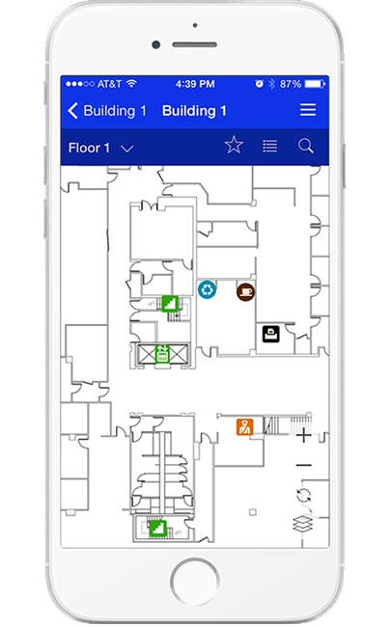
Problem Statement
Work independently !
Centralized system defend on decisions
Vertical Mapping the traditional way
Properties of Vertical Maps ( number of floors, height of each floor )
Techniques of vertical mapping ( infrastructure dependent/independent)
Dynamic vertical indoor mapping
4

Slide 5

Problem Solution
Get Idea from Nature
Example : Swam birds

Slide 6

Questions :
How it works?
How they organized with different structure ?
What are the parameters they use to organized themselves?
This system will remain decentralized?
How to achieve goals like higher robustness, higher efficiency?

Slide 7

PREREQUISITE
The basic idea of self-organisation is to arrange structure at
runtime where agents communicate with each other and take
distributive decision to rearrange themselves via exchanging
information of attributes.

Slide 8

Again Problems
How much a system should be self organized?
How to measure the system is self organized?

Slide 9
Self-Organisation
A distributed system with a large number of autonomous
agents exchanges their local information. As an outcome,
they establish a pattern and maintain self-organized system
this is known as self-organization.

Slide 10
Related Work

Slide 11
Researchers:
Ant colonies in 2010(Dorigo and birattri).
Urban road traffic control system (tomforde et al., 2010)
Definition of self-organisation 2013 (Polani) and 2001 (Shalizi) but mixture with Emergence.

Slide 12
Terms:
CityGML datasets consist of a set of plain text files (XML files) and possibly some accompanying image files that are used as textures.
Each text file can represent a part of the dataset, such as a specific region, a specific type of object (such as a set of roads)
CityGML provides five different levels of detail (LOD) that can be used while generating a city model. These range from LOD0 to LOD4.
complete absence
of external control is not desirable since user influence is part
of the overall concept, see e.g. (Tomforde et al., 2011).

Slide 13
City GML LOD2+
Level of Detail and LOD2+:
Using LOD0 to LOD3, one can define a model with increasing details respectively.
Only LOD4 provides the ability to model the internal geometry of a building.
The more the detail, the more the complexity(not feasible), hence the need for LOD2+
LOD2+ is basically an extension of LOD2 and generates the indoor geometries automatically.
Requires pre-knowledge about buildings for example façade.
This approach is dependent on prior knowledge, hence not very dynamic.

Slide 14
Vertical Steps Identification (ZUPT)
ZUPT(Zero Velocity Update): An algorithm used to identify human steps from the crowd-sourced data.
Intuition: There is always a point when the velocity becomes zero as soon as the foot comes in contact with the ground.
That zero velocity point can be used as a step detection point
Problem: Works perfectly for horizontal transitions, unable to detect the vertical displacements.
Solution: A moving platform detection mechanism to cope with this problem called SLAM.

Slide 15
Vertical Steps Identification (SLAM)
Simultaneous Localization and Mapping (SLAM)
An algorithm used to map an area as well as localize objects in that area simultaneously.
Intuition:
The acceleration caused by the sensor carrier is always greater than the ones surrounding the carrier.
Problems:
Not dynamic enough.
Existing maps are used.
Localization correction instead of localization.

Slide 16
Altitude Estimation Using Reference Station
Altitude estimation using Barometric formula:
Difference in calculated pressure varies from 2.1Pa to 2.5Pa
This variation of pressure could cause the change of 10m height
10m = more than five floors
Latency and accuracy estimation:
0.1hPa change in pressure every 10 minutes.
Problem:
Almost impossible to calculate accurate height of floor.
Solution:
Use a reference station
Problem:
Not always nearby
Requires calibration incase of other devices, not realistic.

Slide 17
Altitude Estimation ( Multiple Barometers )
Use multiple barometers as reference points for the floor positioning of smart-phones with build-in barometric sensors.
It is robust against temperature and humidity.
Considers the difference in the barometric-pressure change trends at
different floors.
Intuition: Atmospheric pressure decreases as the altitude increases.
Capable of achieving a good discretization between different floor levels based on the following
Barometric formula
Barometric Sensors
Local Weather Station Report
Problem:
Heavily dependent on existing infrastructure.

Slide 18
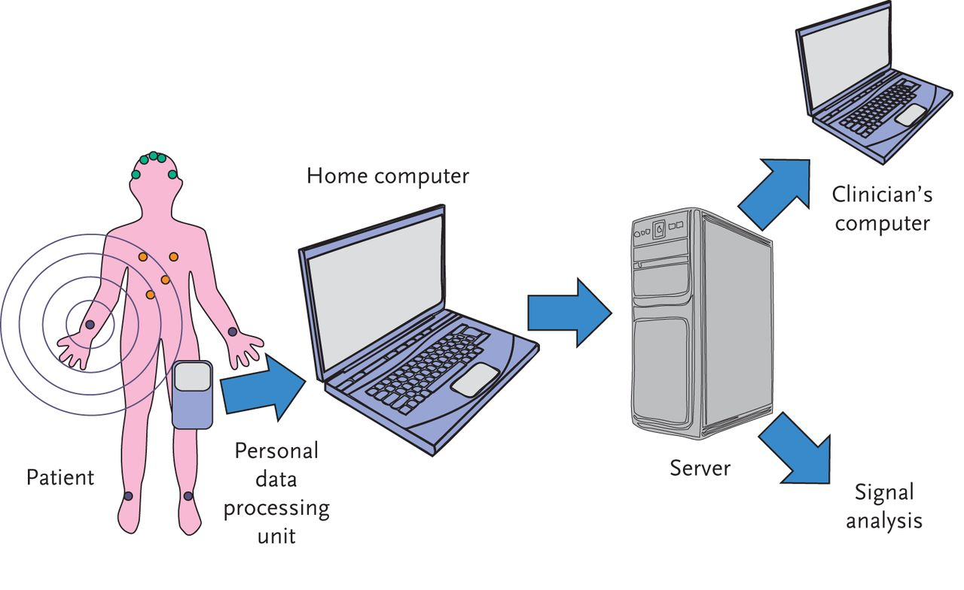
Altitude Estimation in Medical Equipment
Patient’s altitude needed to perform surgery using electronic equipment.
Triangulation, requires direct line of sight, not easily calculated.
Barometer Sensors, multiple barometer sensors installed on body, one reference sensor on a stationary point.
Sensors are calibrated to remove the offset and get the right altitude.
Focuses on better accuracy of altitude.
We need infrastructure independent technique.

Slide 19
Altitude Estimation( GPS / Ad-hoc Points )
GPS is used for altitude estimation in an outdoor environment by the cellular networks.
Vertical displacement error is twice the horizontal displacement, hence infeasible.
The use of ad-hoc reference points.
Connect to all the available reference points.
Rate the reference points based on their closeness in distance and time.
Assign credibility to the reference stations based on the known location and accuracy of pressure value information.
Score errors less that 3m in outdoor walking, 6m in mountain climbing, 0.9m in indoor floor localization.
Ad-hoc reference point will constantly have the need of connecting and calculating.

Slide 20
Main Approach

Slide 21
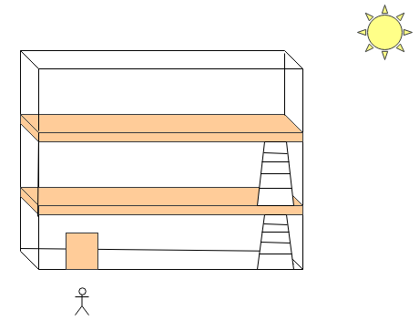
Scenario

Slide 22
Data Flow
Reference Pressure Extraction
Stair Removal
CityGML Model
Signal Filtering
Altitude Estimation
CityGML Generator
Sensor Data Collection
Data Aggregation
Number Of Floor Estimation
Server
Smart Phon 1
Smart Phon 2
Smart Phon 3
Smart Phon 4
Smart Phon 5
Smart Phon n
Client

Slide 23
Sensor Data Collection
Smart-phone application called “Record Data”
Client server architecture
Data sent via HTTP protocol in JSON format
Data collected from sensors
Pressure
GPS
Light
Proximity
Stored in DB with unique id.
The data is collected during different days, different times in a day, with different temperature and humidity conditions.
The temperature and humidity are collected from the weather services.

Slide 24
Sensor Data Collection

Slide 25
Signal Filtering
Suggested filters are Moving Average, Savitzsky Golay and Median filers.
Savitzsky Golay: Takes all the neighbors of the current index within a specified range, takes an average and replaces it with the current value.

Slide 26
Reference Pressure Area
The reference pressure is essential for estimating the altitude
Needed by the barometric formula.
Extracted from areas that cover the following preconditions:
Common for all user data of each building
Located indoors
Pressure fluctuations are low
This area follows the Outdoor-Indoor Transition (OITransition)
Approach:
GPS uncertainty
Hysteresis thresholding,
better classification of low and high
GPS readings.

Slide 27
Reference Pressure Area
Light intensity varies from indoor to outdoor.
Hysteresis thresholding, maximizing the margin of signal that belongs outdoors and indoors.
Binary classification, based on high and low frequencies.
If the data belong to day or night is taken as follows:
Latitude of Observer
Hour Angle(Sunrise/Sunset)
Sun declination

Slide 28
Stair Removal
Features with high disturbances are rejected.
Mostly correspond either to vertical transitions (e.g. stairs or elevators) or to outliers(e.g. high wind velocities).

Slide 29
Altitude Estimation
The altitude is estimated by the formula induced from barometric formula as follows:

Slide 30
Data Aggregation
Data needs to be aggregated.
Not all users visit each floor.
Grouped by a GPS radius, correspond to the same building.
More specific, altitudes estimated from multiple users via their unique users identifier (UUID) and shorted by their timestamp and fused together for the classification phase.
No need for sensor calibration, data collected by same device at the same location.
We assume that every entrance of a building is at the same altitude.

Slide 31
Number of Floor Estimation
The classifier K-Means is selected because of its popularity and its relatively low processing demand.
Identification of k:
The elbow method is designed to help finding the appropriate number of clusters in a data set.
Plot the variance against the number of clusters.
The first clusters will add much information but at some point the marginal gain will drop, giving an angle to the graph.
The number of clusters is chosen at this point.

Slide 32
Number of Floor Estimation
The Center of Clusters:
K-mean is applied.
Inputs are the computed as vector of filtered pressure data and “k”.
Output is a vector with the assigned classes for every input point and the cluster centroids.

Slide 33
CityGML Implementation

Slide 34
Evaluation

Slide 35
Phone Poses
In every 600 unique pressure readings, the maximum vertical displacement does not go beyond 30 cm.
Hence assumed that the effect of these changes on data(pressure) is minor.

Slide 36
Stair Removal
Walking Velocities = (1x, 1.5x, 2x)
Stairs = 10
Precision of 93.8%, recall 95.5% and F-Score 94.6%

Slide 37
Reference Pressure Area
Buildings Used = 3
Collected Data Sets Per Building = 4
Data Collection Times = Day and Night
The OITransition is identified successfully and the entrance can also be approximated within the values of latitude = 1.6 m and longitude = 5.5 m and can be seen in the figure below.

Slide 38
Number of Floor Estimation
Scenario 1:
Data Sets = 5(a, b, c, d, e), People = 5, Floors = 5, Days = 5
Scenario 2:
Data Sets = 5(a, b, c, d, e), People = 5, Floors = 1, Days = 5

Slide 39
Altitude Estimation

Slide 40
Conclusion
Dynamic mapping of the vertical characteristics of a building.
Managed uncertain sensor data, collected via crowdsourcing.
Estimated the altitude of each of these collected data sets via the barometric formula.
Extraction of reference pressure during the outdoor-to-indoor-transition of the user inside a building, which is identified through sensor fusion.
Faced an unsupervised classification problem, where the number of floors as well as the altitude of each floor are unknown.
Proposed a way to map those characteristics while enhancing the standards of the CityGML.

Slide 41
References
[1] G. Liu, M. Iwai, Y. Tobe, D. Matekenya, K. M. A. Hossain, M. Ito, and K. Sezaki, “Beyond horizontal location context: measuring elevation using smartphone’s barometer,” in Proceedings of the 2014 ACM International Joint Conference on Pervasive and Ubiquitous Computing: Adjunct Publication, pp. 459–468, ACM, 2014.
[2] B. Li, B. Harvey, and T. Gallagher, “Using barometers to determine the height for indoor positioning,” in International Conference on Indoor Positioning and Indoor Navigation, pp. 1–7, Oct 2013.
[3] H. Xia, X. Wang, Y. Qiao, J. Jian, and Y. Chang, “Using multiple barometers to detect the floor location of smart phones with builtin barometric sensors for indoor positioning,” Sensors, vol. 15, no. 4, pp. 7857–7877, 2015.
[4] D. J. Ketchen Jr and C. L. Shook, “The application of cluster analysis in strategic management research: an analysis and critique,” Strategic management journal, pp. 441–458, 1996.
[5] R. Boeters, K. A. Ohori, F. Biljecki, and S. Zlatanova, “Automatically enhancing citygml lod2 models with a corresponding indoor geometry,” International Journal of Geographical Information Science, vol. 29, no. 12, pp. 2248–2268, 2015.
[6] S. Kaiser and C. Lang, “Detecting elevators and escalators in 3d pedestrian indoor navigation,” in 2016 International Conference on Indoor Positioning and Indoor Navigation (IPIN), pp. 1–6, Oct 2016.
[7] C. Bollmeyer, T. Esemann, H. Gehring, and H. Hellbr¨uck, “Precise indoor altitude estimation based on differential barometric sensing for wireless medical applications,” in Body Sensor Networks (BSN), 2013 IEEE International Conference on, pp. 1–6, IEEE, 2013.
[8] A. Savitzky and M. J. E. Golay, “Smoothing and differentiation of data by simplified least squares procedures.,” Analytical Chemistry, vol. 36, no. 8, pp. 1627–1639, 1964.
[9] T. H. Kolbe, G. Gr¨oger, and L. Pl¨umer, CityGML: Interoperable Access to 3D City Models, pp. 883–899. Berlin, Heidelberg: Springer Berlin Heidelberg, 2005.
[10] “3d City Database: citygml4j.” http://www.3dcitydb.org/3dcitydb/citygml4j/.
[11] P. G., “RecordData.” https://play.google.com/store/apps/details?id=com/recordData.basic&hl=en, Jan. 2017.

Slide 42
Thank You
Questions Please… !

